Slide 1
Credit card default
NITHARWAL ASHWANI
NOOR AYESHA
NGUYEN THI QUYNH ANH

Slide 2
INTRODUCTION
Pre-process data & Base Table
Feature Reduction
Modeling

Slide 3
1. Preprocess Data & Base Table

Slide 4
Pre-processing data
Checking missing value (NA)
Dropping variables with high missing percentage
Treating NA values
Checking outliers
Creating new variables

Slide 5
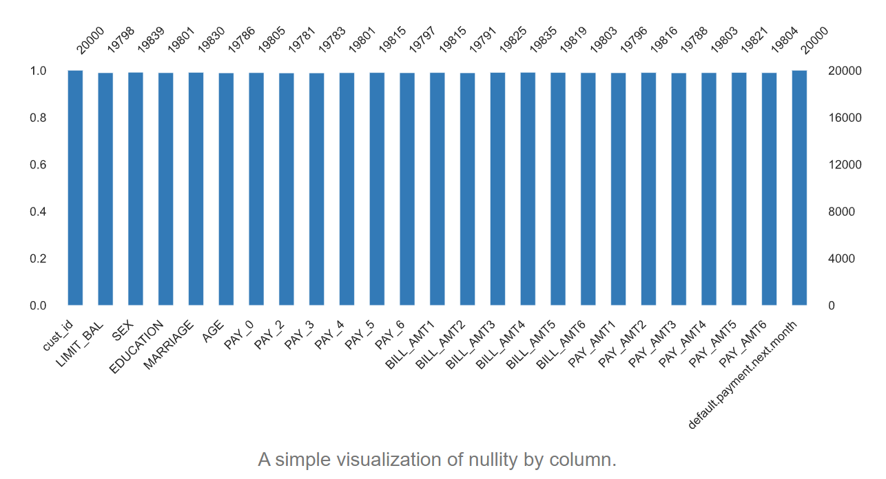
Missing values
Checking missing value

Slide 6
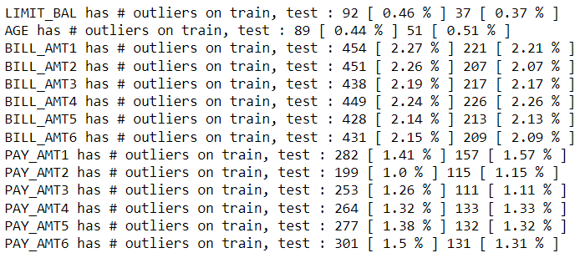
Outlier capping
(mean-3*sd, mean+3*sd)

Slide 7
EDA graphs analysis

Slide 8
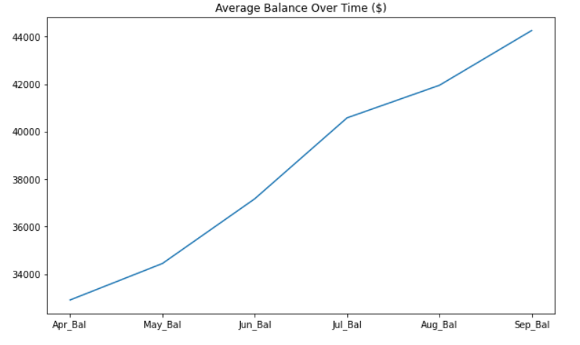

Slide 9
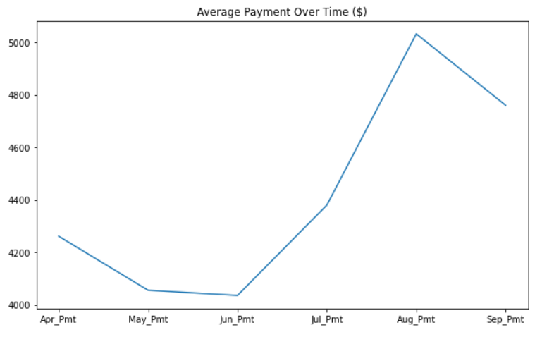

Slide 10
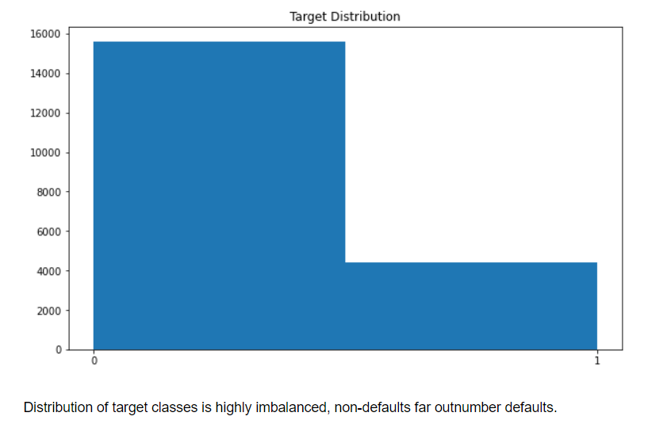

Slide 11
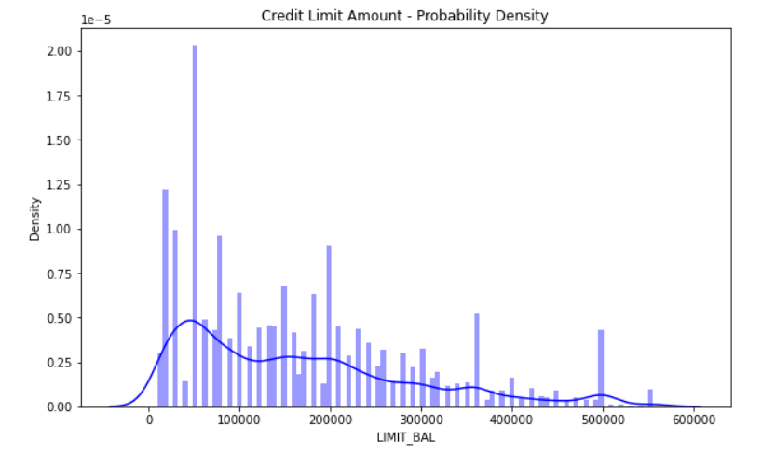

Slide 12
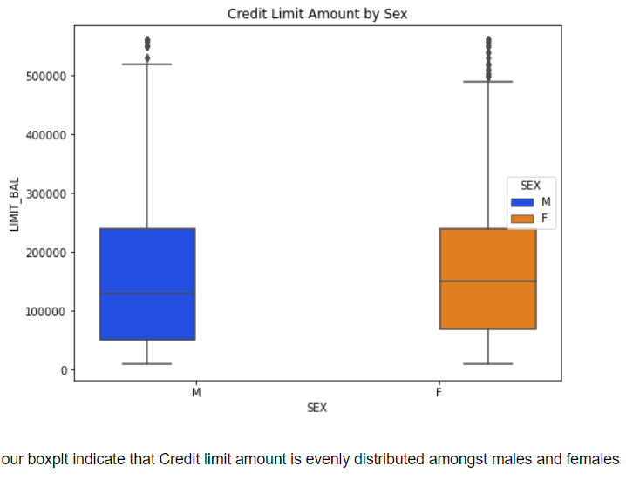

Slide 13
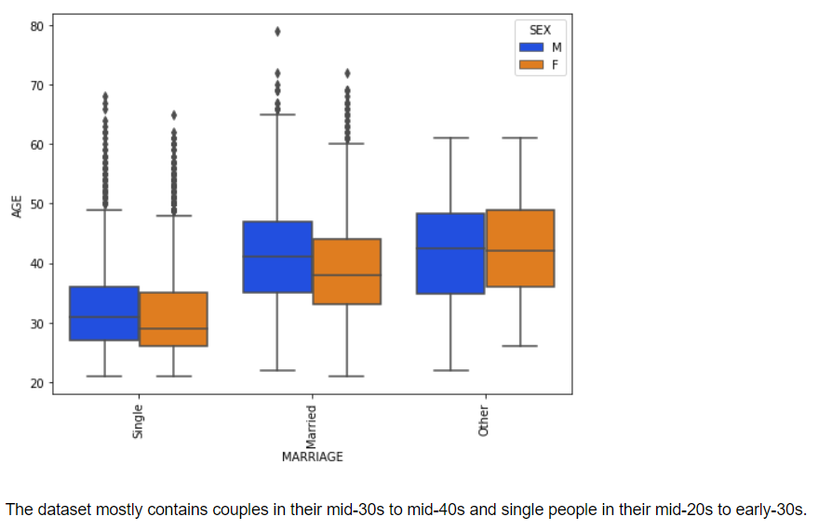

Slide 14
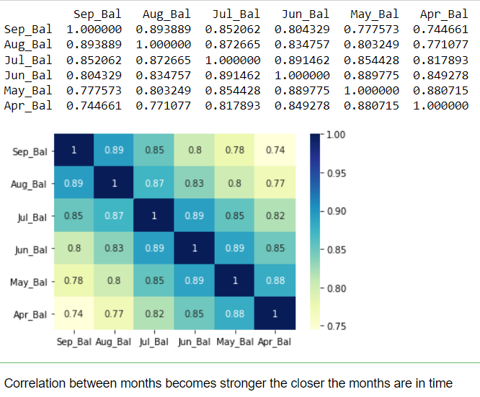
Correlation heatmap For Balance

Slide 15
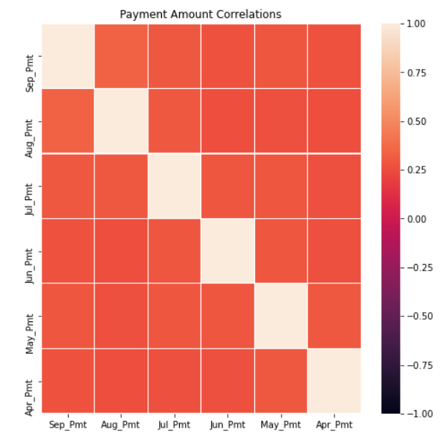
Correlation Plot Payment Status
Payment status. Correlation strength increases the closer the months are in time. Makes sense. For example, one could assume a late payment in August would likely lead to a late payment in September. However, it is less clear we can make the same assumption for April and September

Slide 16
2. Feature Reduction

Slide 17
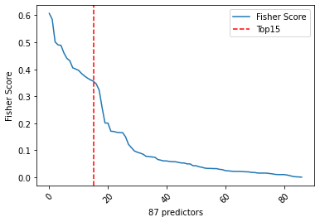
Fisher Score

Slide 18
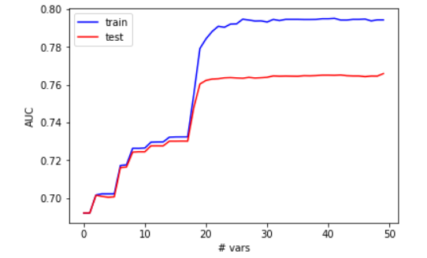
Check how AUC change when add more variables: Top n vars

Slide 19
3. Modeling

Slide 20
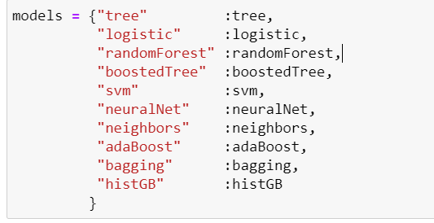
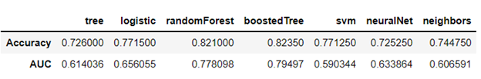
Models used :

Slide 21
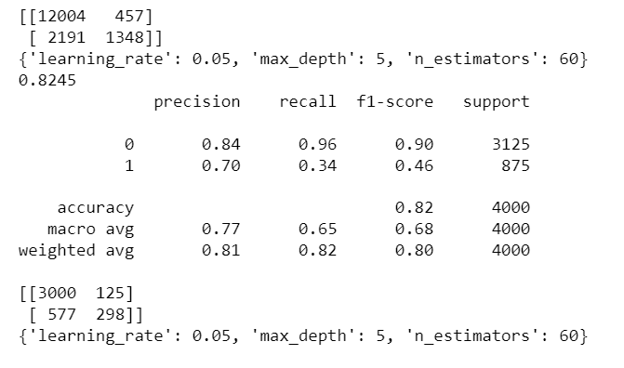

Grid Search CV on XGBoost

Slide 22
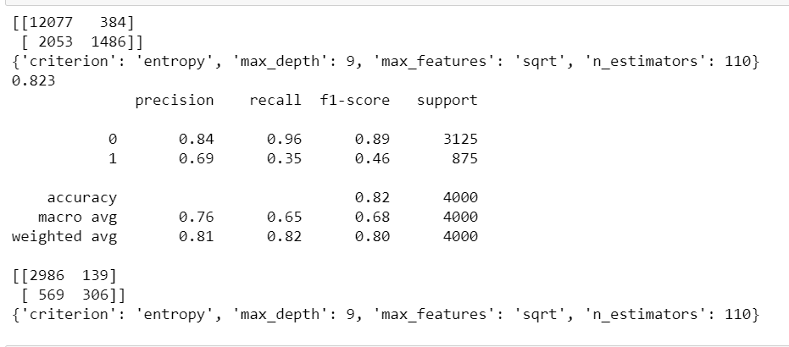

Grid Search CV on Random Forest

Slide 23
THANK YOU

